Slide 1
Practical Automation
A journey into information security automation

Slide 2
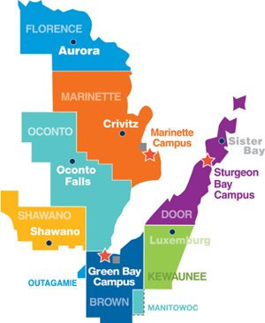
About NWTC
40K customers, 2,400 employees
10,000+ devices
400 unique software applications
3 campuses, 5 regional centers, and 4 outreach (specialty) centers
___________________ Anne Koors – Network Security Administrator
Nate Wesolowski – Information Security Specialist

Slide 3
Agenda
Our journey into information security automation…
Present state
Examples
Lessons learned
What’s next?

Slide 4
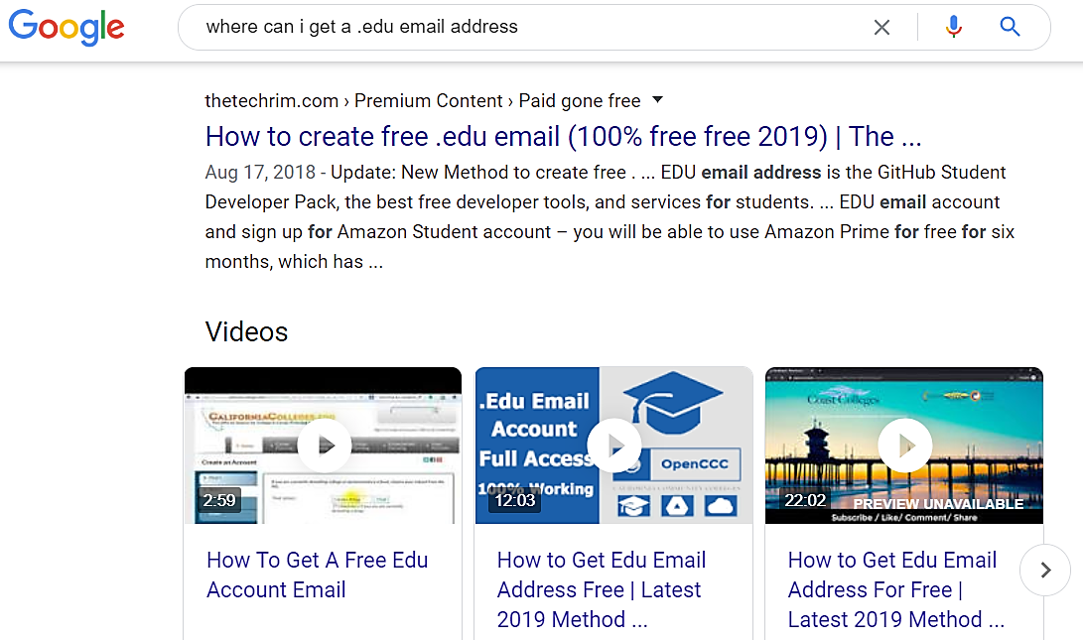
Our Story
Notes:
Our journey into security automation began in the summer of 2018 when we uncovered abuse of our on-line, self-service registration portal.

Slide 5
Discovery Phase
“Almost all of our security tools supported some level of automation”
Notes:
After our initial success, we were left wondering, well this was pretty cool, what else can we do with automation?

Slide 6
Email Alert Generated
Automated Action
Email Alert Processed
Task Performed
Design/Build

Slide 7
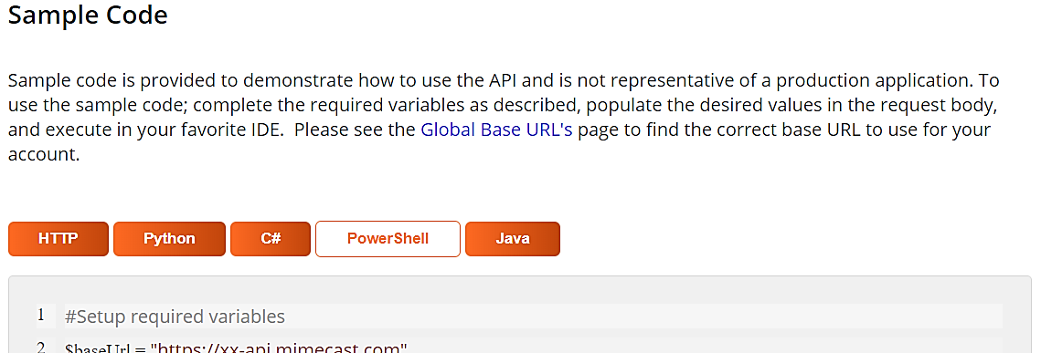
Block Email Address or Domain (PowerShell script provided by vendor) ./BlockSender.ps1 –address scam@domain.com
cURL Example – retrieve report from malware sandbox curl.exe -JO -F apikey= $apiKey -F hash=$hash -F format=pdf https://wildfire.paloaltonetworks.com/publicapi/get/report
Updating Dynamic Lists/Feed Files echo 167.99.96.100/32 >> "\\server1\share1\ip_blocklist.txt" Add-Content -Path "\\server1\share1\ip_blocklist.txt" -Value "167.99.96.100/32 #Phishing“
Purge Email from Exchange Mailbox Search-Mailbox -Identity victim@yourdomain.com -SearchQuery 'From:scammer@baddomain.com' -DeleteContent –Force
DHCP Block List Add-DhcpServerv4Filter –ComputerName “dhcp.yourdomain.com" -List Deny -MacAddress "28-f1-0e-3c-6a-f6" -Description "Unauthorized Device: kali-linux666 12/20/18"
Notes:
Take the time to look-up the API documentation or CLI equivalents for your manual tasks.

Slide 8
Present State
SIEM/Flow App
Flow App
Flow App
Email Alert or On-Demand Action
Text Extracted
Text Sent to a File
File Transferred to On-Prem Server
PowerShell Reads File
Actions Performed Based on File Contents
Actions Logged, Confirmation Email Sent
Data GW
PowerShell
PowerShell
PowerShell
Notes:
Workflow Example:
SIEM generates an alert or Flow Button is pressed (on-demand).
Flow extracts the body from an email alert or takes user input from Flow button.
Flow places the email body text or input from the flow button into a text file. The text file name is specific to the automated action.
Examples:
Block an IP, filename = blockIP.txt, contents = 100.6.6.6
Purge Email from O365, filename = purgeEmail.txt, contents = bobscammer@domain.com
Flow sends the text file to the on-prem Windows server via the Flow Data Gateway app, the file is copied to the Flow directory "c:\flow\"
A continuously running PowerShell script on the on-prem server detects the new file in "c:\flow“ and performs actions based on the file name and text within the file.
Actions are logged to a file and an email notification is sent to the security team.

Slide 9
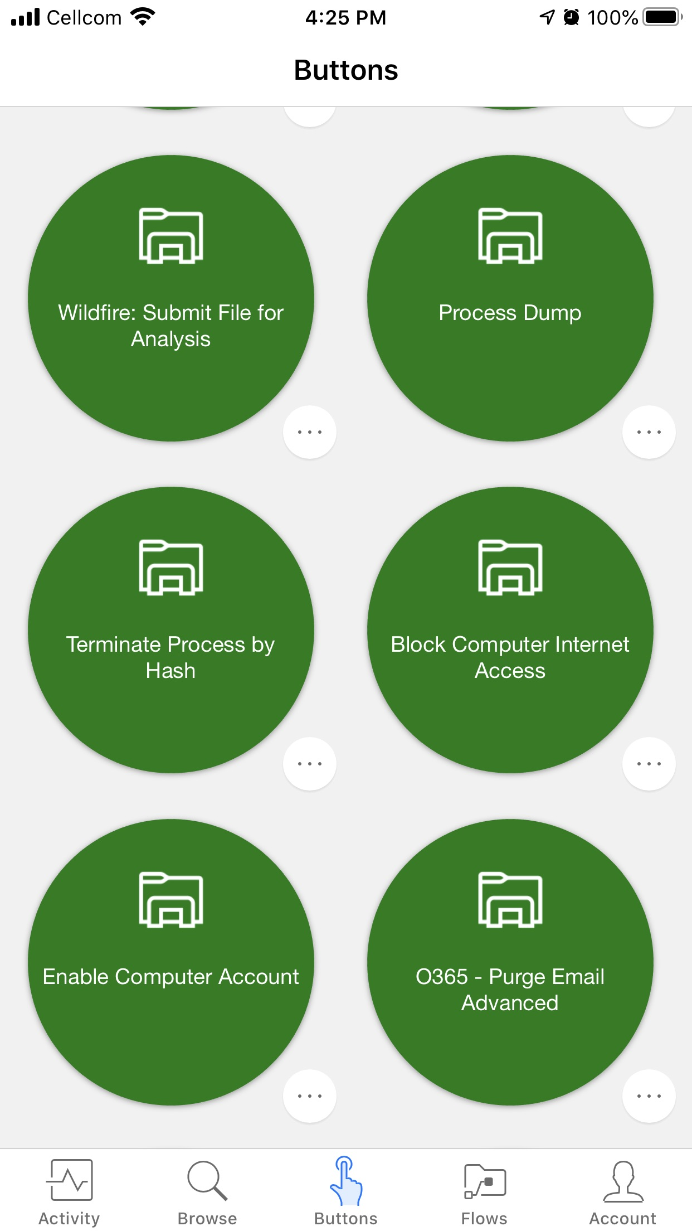
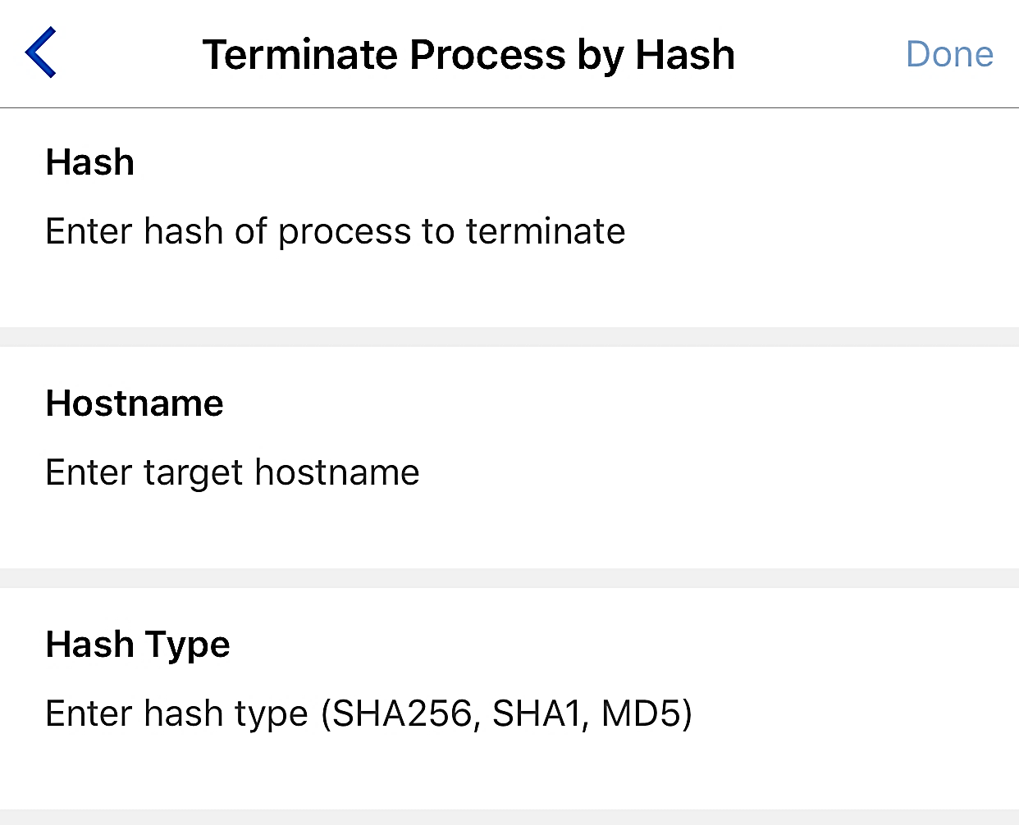
On-Demand Workflows
Examples:
Quarantine Computer
Un-Quarantine Computer
Terminate Process
Disable Keyboard & Mouse
Run PSRecon (Forensics)
Wake on LAN
Send Computer Notification
Block Email Address or Domain
Add IP to Watch List
Virus Total: Check Running Processes
Enable Computer Account
Disable Computer Account
Purge Email Exchange Online
Block URL
Block IP
Block User Internet Access
Enable User Internet Access
Block Domain
Restart Computer
Run Traps Scan
Terminate Process All Computers
Deactivate User Access
DHCP Block List
Block Outbound Email Sender
Run Packet Capture
Get User Info
Shutdown All Domain Computers
Notes:
Example of on-demand workflows. These have a primary benefit of time-savings during an incident response scenario.

Slide 10
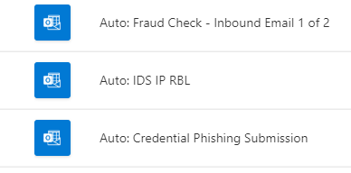
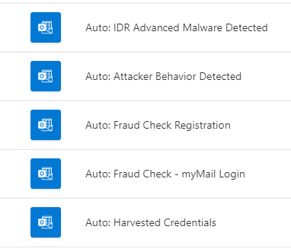
Automated Workflows
Password Guessing Attack
Malware Email Sender
Suspicious Sign-On Detected
“24/7 Coverage”
Notes:
The second type of workflow is our “automated workflows”. These are almost like extension of the team, giving us the ability to automatically address a wide range of security concerns 24/7. We also use them for maintaining internal threat intelligence feeds.

Slide 11
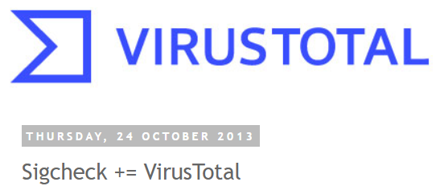
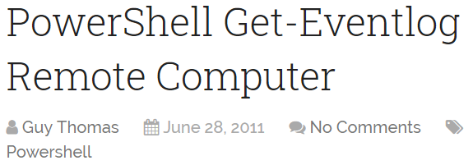
Informational Workflows
Notes:
We use informational workflows to simply speed up investigations. By automatically collecting endpoint data you are not only staving time, but also capturing important artifacts that may otherwise be missed or overwritten by waiting.

Slide 12
Lessons Learned
Use caution when automatically blocking.
Know your systems. Blocking an IP on your firewall does not necessarily block access to cloud services.
Manage credentials, API Keys and certificates with care.
Log automated tasks for future reference and debugging.
Be mindful about using privileged accounts to connect to potentially compromised machines.

Slide 13
Future Plans
Asynchronous/simultaneous processing
Webhooks instead of Email Alerts
Enterprise SOAR Solution

Slide 14
Question/ Answer

Slide 15
References
UPLOAD AND RUN AN ON PREMISES POWERSHELL SCRIPT FROM MICROSOFT FLOW: https://sergeluca.wordpress.com/2017/12/01/upload-and-run-a-remote-powershell-script-from-microsoft-flow/
Flow of the Week: Local code execution: https://flow.microsoft.com/en-us/blog/flow-of-the-week-local-code-execution/
Notes:
This project was inspired by the following resources:
UPLOAD AND RUN AN ON PREMISES POWERSHELL SCRIPT FROM MICROSOFT FLOW - https://sergeluca.wordpress.com/2017/12/01/upload-and-run-a-remote-powershell-script-from-microsoft-flow/
Flow of the Week: Local code execution - https://flow.microsoft.com/en-us/blog/flow-of-the-week-local-code-execution/

